Slide 1

#GROUP 6 (MIS 6382.501 - Object Oriented Programming in Python – F24) Name: Byte by Byte

Slide 2

Outcome: Provide actionable insights for job seekers and employers to improve hiring strategies and decision-making.
Objective: Analyze job application data to uncover trends in salaries, experience requirements, job types, and interview difficulty across companies.
Dataset: Contains detailed job application records, including salary, experience, job type (Tech or non-Tech), company, and interview difficulty.
Key Goals: 1) Understand salary distribution by experience, job type, and company. 2) Identify trends in job types (Tech vs. non-Tech) across companies. 3) Explore the relationship between interview difficulty and hiring trends.

Slide 3
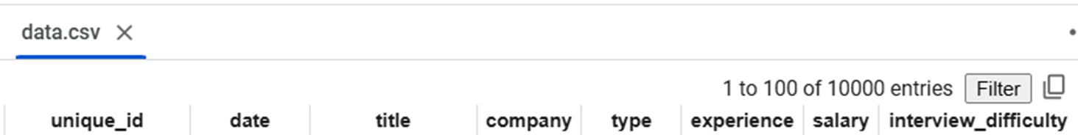
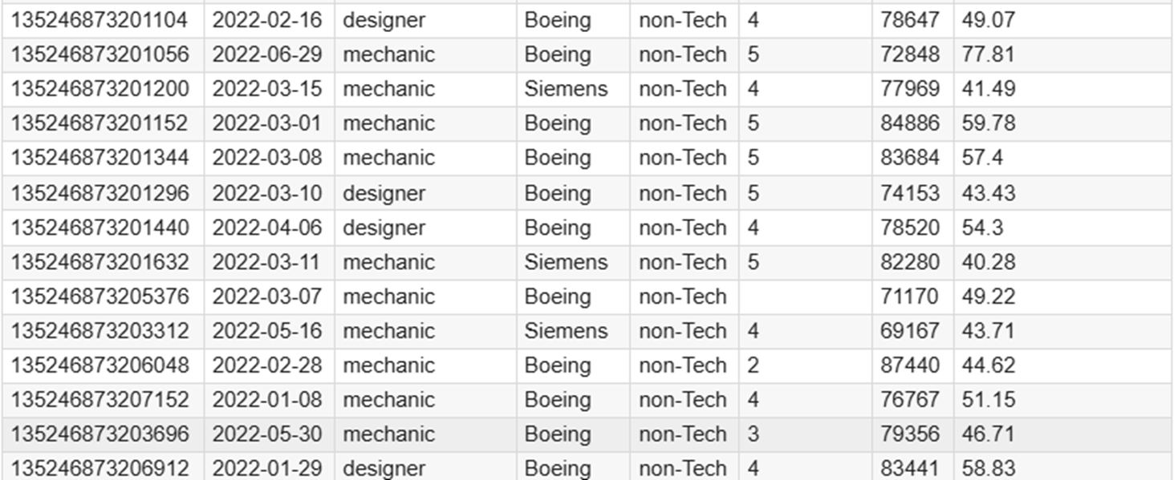
Dataset screenshot

Slide 4
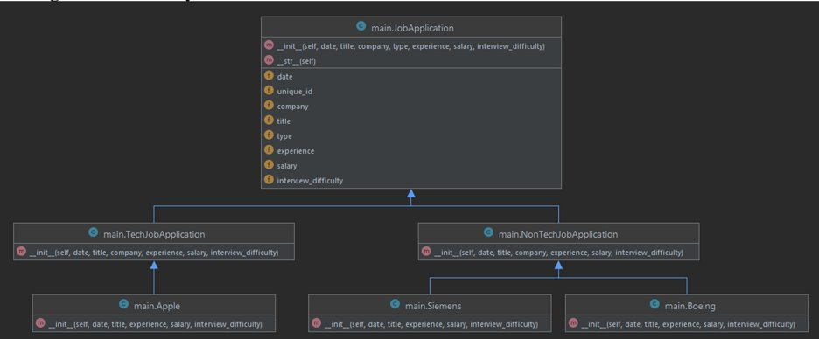
Class diagram/ hierarchy

Slide 5
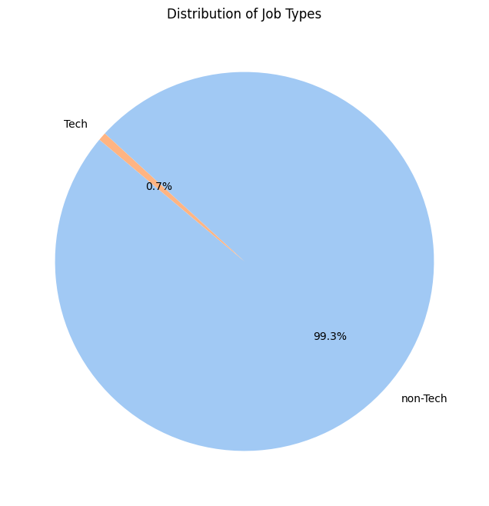
Distribution of Job Types (Pie Chart)
Key Observations:
Non-Tech Dominance: 99.3% jobs are non-Tech.
Tech Roles Rare: Only 0.7% are Tech jobs.
Implications:
Job-Seekers: Non-Tech candidates have ample opportunities.
Employers: Diversify into Tech roles for balance.

Slide 6
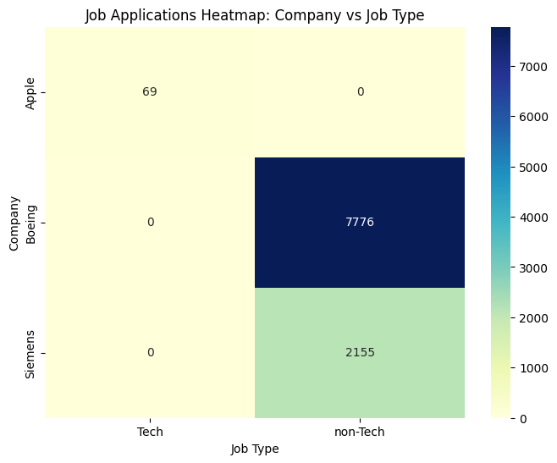
Heatmap Using Categorical Variables
Key Observations:
Apple: Focuses only on Tech roles with 69 applications.
Boeing: Dominates non-Tech roles with 7,776 applications.
Siemens: Specializes in non-Tech roles with 2,155 applications.
Implications:
Job-Seekers: Tech jobs at Apple, non-Tech at Boeing/Siemens.
Employers: Apple can add non-Tech; Boeing/Siemens can expand Tech.

Slide 7
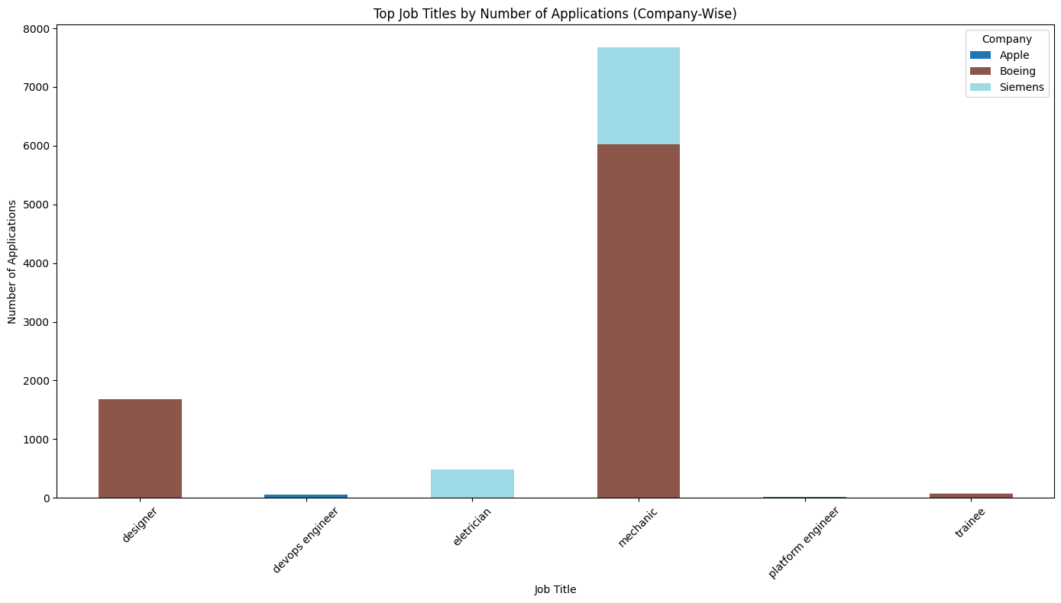
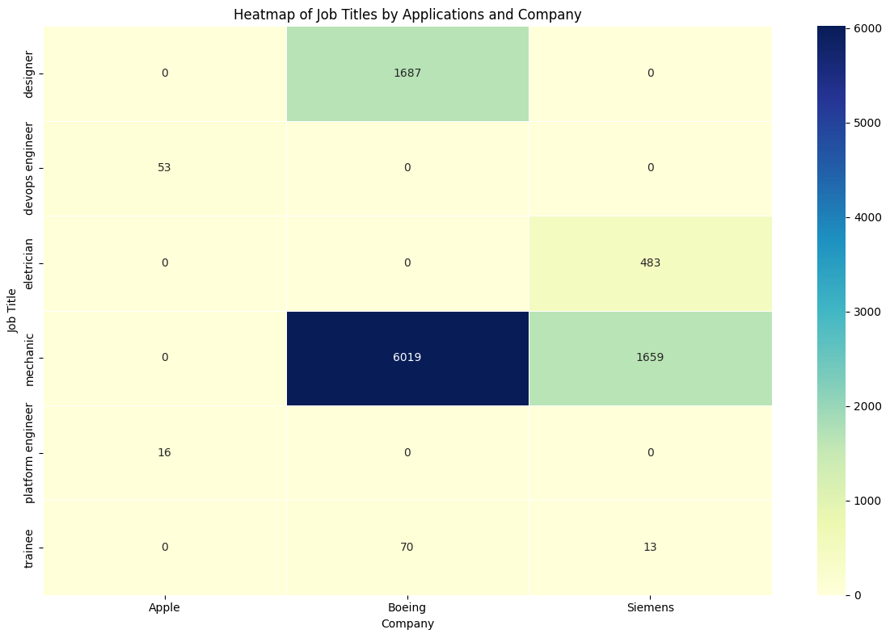
Top job titles (Stacked bar chart )
Key Observations:
Mechanic Dominates: Highest applications (77%), led by Boeing and Siemens.
Boeing contributes 78% of the total Mechanic applications.
Designer Role: Second-highest, entirely at Boeing.
Tech Jobs: Minimal applications, exclusively at Apple.
Electrician: Siemens specializes in technical trade roles.
Implications:
Job-Seekers: Boeing/Siemens for non-Tech; Apple for Tech.
Employers: Apple can diversify; Boeing/Siemens can expand offerings.

Slide 8
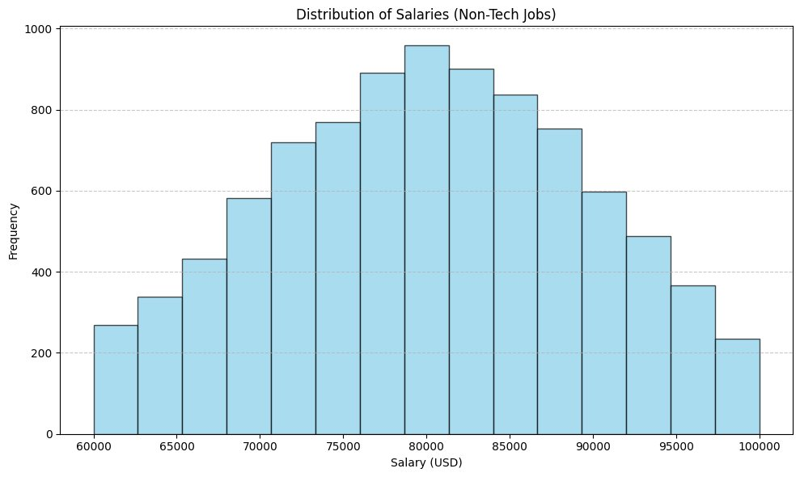
Histogram for salary distribution (Non-Tech jobs)
Key Observations:
Most Common Range: $75,000–$85,000 has the highest frequency.
Tails: Few jobs at <$70,000 or >$90,000.
Symmetry: Salaries are evenly distributed around the mean.
Implications:
Job-Seekers: Most roles pay $75,000–$85,000.
Employers: Competitive salaries cluster in the mid-range.

Slide 9
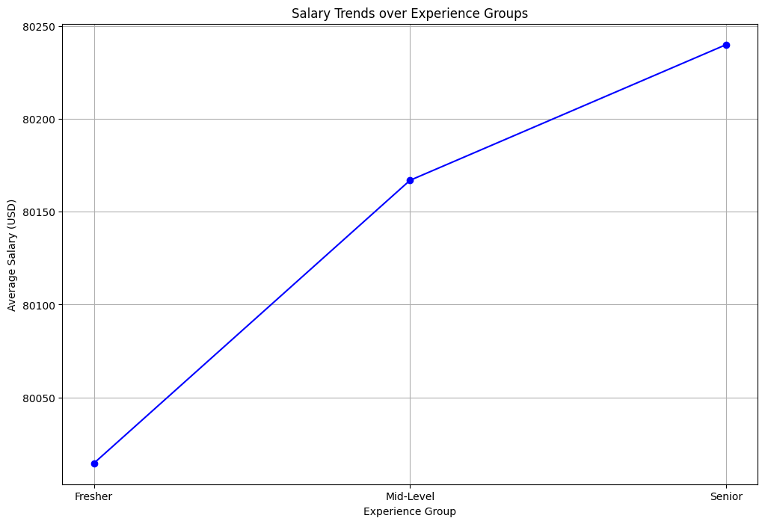
Salary trends based on experience groups (Line chart)
Key Observations:
Upward Trend: Salary increases with experience.
Freshers: Lowest average salary.
Mid-Level: Moderate salary growth from Freshers.
Senior: Highest salary, showing value for experience.
Implications:
Job Seekers: Experience brings noticeable salary benefits.
Employers: Competitive increments needed to retain Senior talent.

Slide 10
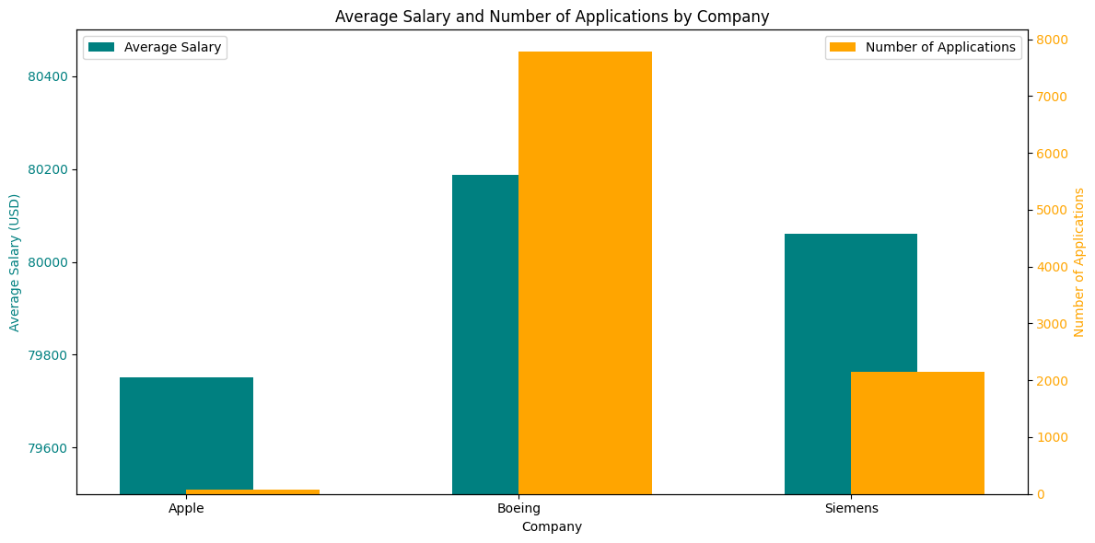
Average Salary and Number of Applications by Company (Clustered Bar chart)
Key Observations:
Boeing: Highest applications (8000 applications), highest salary.
Apple: Lowest applications (70 applications) and lowest salary.
Siemens: Balanced applications and salary.
Implications:
Boeing excels in volume and attracts high-salary seekers.

Slide 11
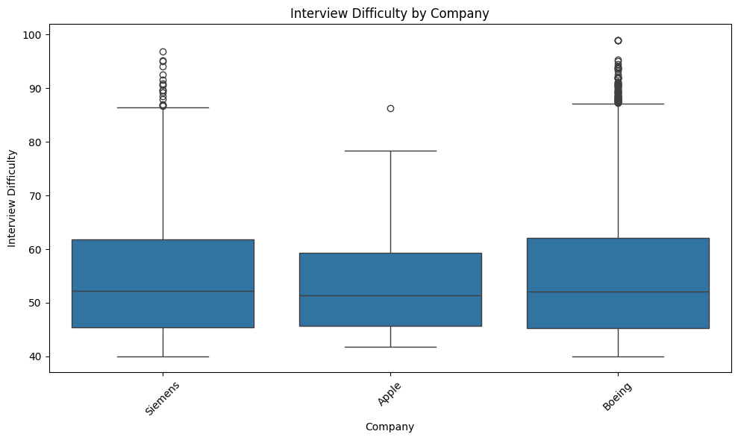
Interview Difficulty by Company (Box Plot)
Key Observations:
Median: All companies' difficulty ranges between 50–55.
Siemens/Boeing: Wide range; many outliers above 90.
Apple: Narrow range; consistent and predictable process.
Implications:
Seekers: Apple offers consistent interviews; Siemens/Boeing vary widely.
Employers: Siemens/Boeing can reduce variability; Apple’s approach appeals.

Slide 12
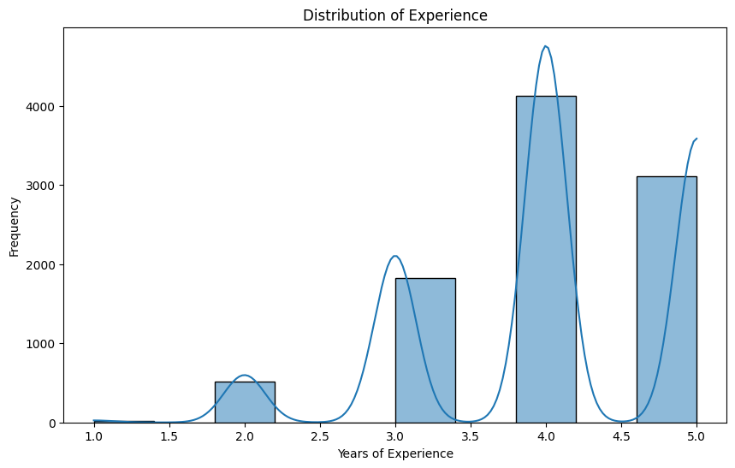
Experience Distribution (Histogram)
Key Observations:
Peaks: Jobs target 3–5 years experience mostly.
Low Demand: Few jobs for <2 years experience.
Mid-Level Focus: 3–5 years dominates job market.
Implications:
For Seekers: 3–5 years experience has most jobs.
For Employers: Add roles for senior and entry-level talent.

Slide 13
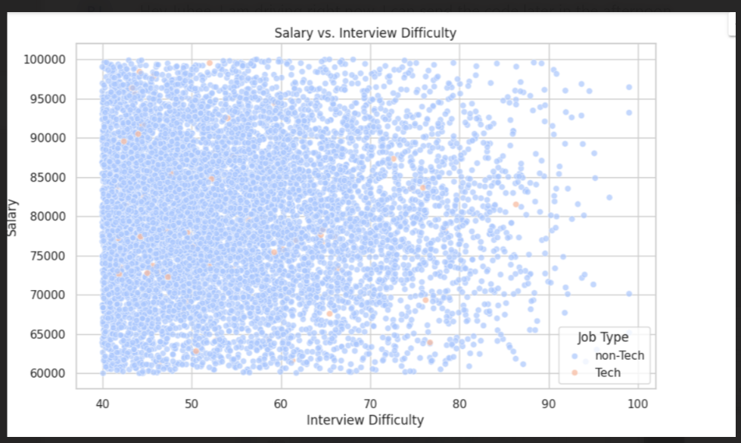
Salary VS Interview Difficulty (Scatter plot)
Key Observations:
Most of the Interview difficulty is between 40-60 .
Implications:
No significant relation between interview difficulty and salary ranges
Scatter plot not sufficient to provide conclusion

Slide 14

Key Findings (Conclusion):
Majority of job applications (99.3%) are for non-Tech roles, with Tech roles being minimal (0.7%).
Boeing dominates with 77.8% of job applications, focusing on non-Tech roles, followed by Siemens (21.5%), while Apple focuses solely on Tech jobs.
Salaries are centered around $75,000–$85,000, with fewer roles at extreme ends. Experience influences salaries, with noticeable increments for Senior roles.
Candidates with 3–5 years of experience have the most opportunities, while entry-level roles are limited.

Slide 15

Recommendations
For Job Seekers:
Non-Tech Candidates: Focus on Boeing and Siemens for non-Tech abundant opportunities.
Tech Professionals: Target Apple but prepare for limited roles.
Entry-Level Candidates: Explore companies offering training or fresher programs, as entry-level opportunities are limited.
For Employers:
Diversification:
Boeing/Siemens: Consider adding Tech roles to attract diverse talent.
Apple: Expand into non-Tech roles to balance the portfolio.
Salary Strategy:
Offer competitive pay for high-experience roles to attract top talent.
Interview Process:
Standardize hiring to reduce variability and improve candidate experience.
Apple’s consistent approach can be a model for predictability.

Slide 16
THANK YOU...
Rohan Jyotishi
Mahesh Potdar
Harshitha Reddy Dugganapalli
Juhee Makwana

